Slide 1


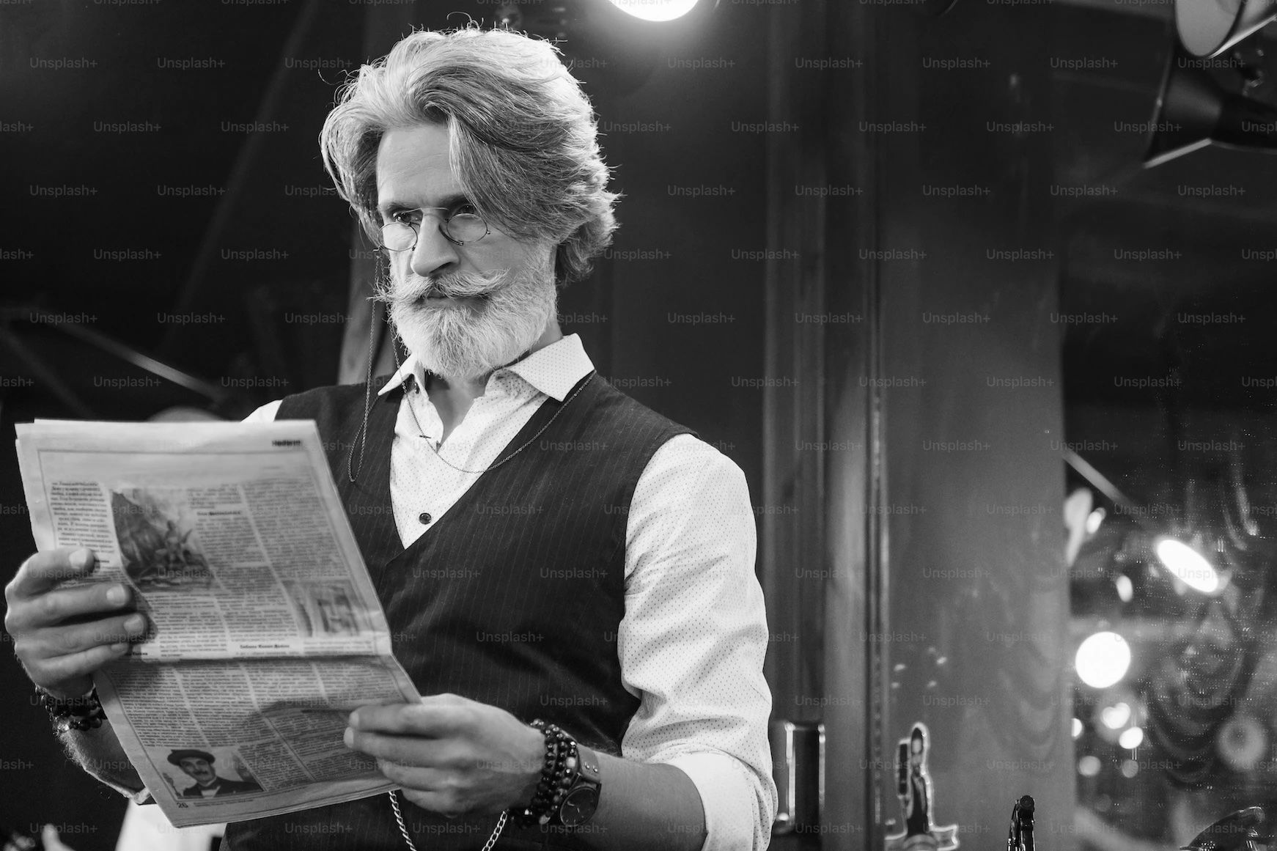
Jennifer Meyer & Olaf Carl’s
Journey to Chillomania Purchase and Beyond
Anokhi, Haanim, Saran, Clement
Notes:
Anokhi

Slide 2


Jennifer Meyer’s children have destroyed the couch.
Notes:
Anokhi
Jennifer Meyer started her marriage with a white couch. It now has an array of children’s food and activity stains. Let us tell you Jeniffer’s journey to purchasing a new couch from Chillomania.

Slide 3
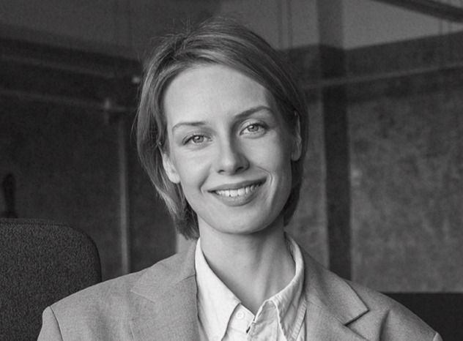
Jennifer Meyer
Trust Pilot
Chillomania website (tracking)
Delivery personnel
Hard copy thank you note (discount voucher)
Chillomania Website
Trust Pilot
Amazon Reviews
Blogs
Awareness
Purchase
Advocacy
Consideration
Retention
(Post-Purchase & Product Arrival)
Google Ads
Pinterest
Youtube Ads
Tik Tok Ads/ Profile
Instagram Ads/ Profile
Chillomania Website
Chillomania Website
Confirmation email
Invoices
Chillomania website.
Thank you note Vouchers
Use of product
Notes:
Anokhi
Awareness: I need a new sofa. Current one has stains from kids. I want a sustainable product that won’t stain, and made in EU. Nervous: Can I fulfil these criteria at an affordable price and the sofa not be ugly. - Browsing for sustainable and stain-proof sofas on Google, Pinterest, Youtube, Blogs, Instagram, TikTok. Read reviews of Sofa brands on Trust Pilot and Amazon.
Consideration: I compare different brands that fulfil her criteria. Fear: I just discovered how expensive couches can be. Excited: I found a designer couch that fulfils my criteria and has a flexible payment plan.
Purchase: It was a smooth transaction since there were many payment options for me and i got a quick confirmation after the payment with estimated delivery date.
Retention . Delivery was timely with careful handle and assemble.Sofa was really what i was expecting. Thank you note contains discount vouchers for Jennifer and friends.
Advocacy. The Sofa is made of quality materials I cannot hide my joy by sharing photos on my social media channels tagging Chillomania. Writing positive reviews.

Slide 4
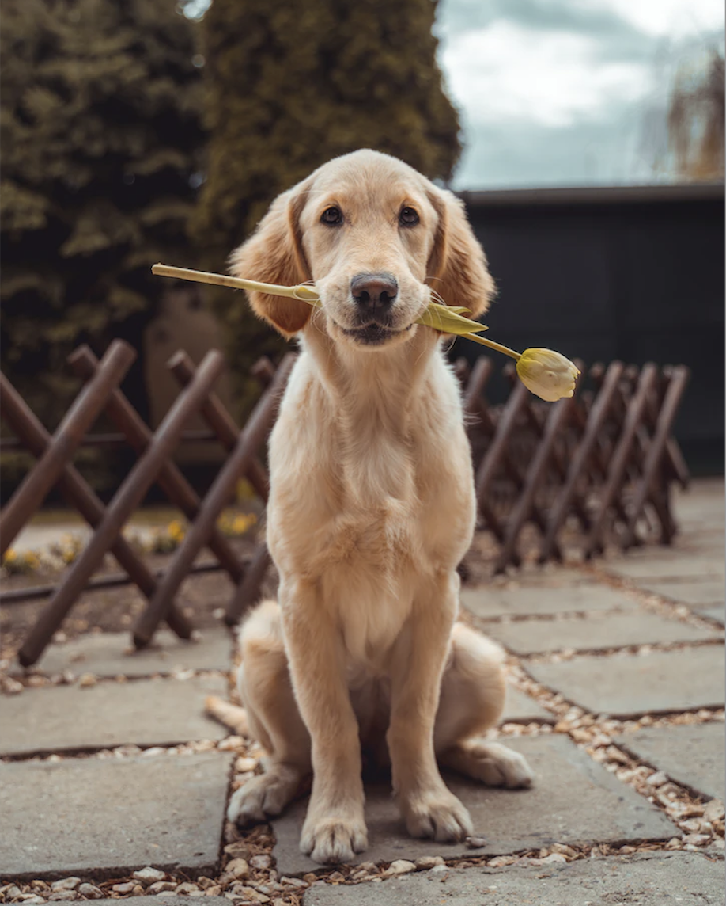
Olaf’s couch is now almost as old as he is.
Notes:
Haanim
Olaf’s couch is being held up by books and bricks. At a glance, the old couch has a furry cover but it’s actually Frankie’s fur, Olaf’s dog. Olaf is not on any social media, so his journey was quite different from Jennifer’s.

Slide 5
Olaf Carl
Trust Pilot
Delivery personnel
Hard copy thank you note (discount voucher)
Chillomania website
Chillomania customer service
Awareness
Purchase
Advocacy
Consideration
Retention
(Post-Purchase & Product Arrival)
Sud Deutsche Zeitung online
Chillomania Website
Chillomania Website
Confirmation email
Invoices
Chillomania website.
Thank you note Vouchers
Use of product
Notes:
Haanim
Awareness: Style is important to Olaf and furniture shops he has visited had basic designs. Olaf reads German newspapers on his iPad and saw a Chillomania ad for a very interesting sofa. He clicked through to find many interesting designs on the website. He gets really excited.
As he considers his options, Olaf feels nervous about buying such an expensive item online but is intrigued by the designs and pet-friendliness. He calls Chillomania and feels more confidence once he speaks to a customer care agent. The person on the line encourages to visit the Chillomania boutique in Hamburg.
Olaf visits the Chillomania boutique and has full confidence upon seeing the couch in real life and hearing about the pet-friendly feature, after sales service, free pick up and recycling of his old sofa and warranty details. He makes his purchase in the boutique. The confirmation email pings on his iPad along with tracking details and a delivery date.
Delivery was timely with careful handling and assembly. The old sofa was picked up at no cost with assurance that it would be disassembled for recycling. The delivery personnel were friendly and also deliver a Thank You note containing a discount voucher for Olaf’s next purchase and five discount vouchers for him to gift to friends. Olaf is delighted.
Advocacy. Olaf enjoys his couch with his dog and friends. He gives out the discount vouchers when his friends come over and gush over his new couch. He visits the Chillomania site again to use his own discount voucher.

Slide 6








Content
Notes:
Saran Copi.ai - ai powered copywriting tool - ad copy - product descriptions - taglines etc. || free plan 5 projects | 35$ 30 projects per month. Google trends || Free tool | explore and analyse search terms popularity| market research | content creation | SEO Keyword planner || free online tool offered by Google Ads | trending keywords | suggestions | volume trends | cost estimation (cost per click) Screaming frog || crawl and analyze seo issues | generate reports | free Ver SF SEo Spider -500 urls | Paid licenced single version 200$ | team 1000$ 10 users Hootsuite || social media management tool | Free plan and paid plans starts from 49$ up 500$ Mailchimp ||

Slide 7





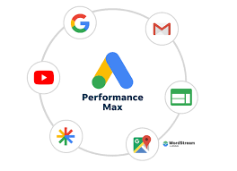


Data and measurement
Notes:
Saran Looker || intelligence and analytics platform that allows organizations to connect, analyze, and visualize their data. Performance max || run ads across multiple g platforms | automated bidding | ML optimized | Audience behaviour in multiple platforms. Tag manager || tag management by Google allows businesses and website owners to manage and deploy tracking codes or tags on their websites without requiring any coding skills. Big Q| cloudbased data warehouse.

Slide 8






Customer Relationships
Notes:
Clement

Slide 9
IN CLOSING
Customer Journey Map
Notes:
Clement
It’s safe to say that the target markets personified by Jennifer and Olaf will cover a large German audience for Chillomania to begin consumer outreach. Their customer journeys are different but as a product, Chillomania fulfils both of their needs. Olaf’s new couch will not be furry and Jennifer will not display a full array of her children’s diet and activities.

Slide 10
Q&A?
Notes:
Please send me the link clement

